Slide 1
The insolvency of the Beate Uhse Group & White & Case
Dr. Sven-Holger Undritz

Slide 2
Beate Uhse – an impressive story

Slide 3
Beate Uhse – an impressive story
1919 Born in Cranz (East Prussia, now Russia) as Beate Köstlin; father – landowner, mother – physician
1937-1944 Trained as a pilot; worked as a test and stunt pilot
1939 Marriage to her former flight instructor Hans- Jürgen Uhse (deceased May 1944)
1944-1945 Pilot with the German Air Force (transferring aircraft from Berlin to the front)
1945 April: Escaped from Berlin by plane to Schleswig-Holstein; six weeks as a British prisoner of war near the German/Danish border

Slide 4
Beate Uhse – an impressive story
1946 Distribution of self-authored leaflets titled Schrift X to educate women about natural contraception → cornerstone of the future Beate Uhse Group
1947 32,000 copies sold at 2 Reichsmark each
1949 October: Marriage to the Flensburg businessman Ernst-Walter Rotermund
1951 22 February: Launched “Versandhaus Beate Uhse” as a specialty mail-order business for marriage guidance and sex education literature and items of sexual hygiene. First criminal prosecution for “aiding and abetting sexual offences” through the shipping of condoms

Slide 5
Beate Uhse – an impressive story
1951 Until her death, police and prosecution investigated Beate Rotermund in about 2,000 criminal cases, with 700 proceedings ending up in court
1952 Publication of first catalogue advertising 50 items; expansion of the company through acquisitions
1962 17 December: Opening of “Specialist store for marital hygiene” (the world’s first “sex shop”); opening a further 25 shops in West Germany by 1971
1975 Reform of the law governing sexual offences; the company rolls out production and distribution of pornographic films

Slide 6
Beate Uhse – an impressive story
1979 Acquisition of “Dr. Müller‘s” with 36 sex shops and 13 blue-movie cinemas; Beate Uhse Group posts an annual turnover of 70 million Deutsche Mark
1981 Formation of Beate Uhse AG in tandem with the split of the company. Beate Rotermund and son Ulrich operate the shops, cinemas and movie business under the umbrella of Beate Uhse AG, while her sons Klaus and Dieter continue the mail- order business and publishing house under the name “Orion Versand”
1986 Upon expiry of the 5-year blocking period agreed at the split, Beate Uhse AG resumes shipping of sex toys and erotica

Slide 7
Beate Uhse – an impressive story
1990 Using vans, Beate Uhse AG expands its business to Eastern Germany. Expansion outside Germany. Annual turnover of 115 million Deutsche Mark

Slide 8
Beate Uhse – an impressive story
1992 Beate Rotermund retires from the management of Beate Uhse AG, becomes chair of the supervisory board
1999 27 May: Beate Uhse AG goes public
2001 Beate Rotermund dies in St Gallen, Switzerland, on 16 July

Slide 9
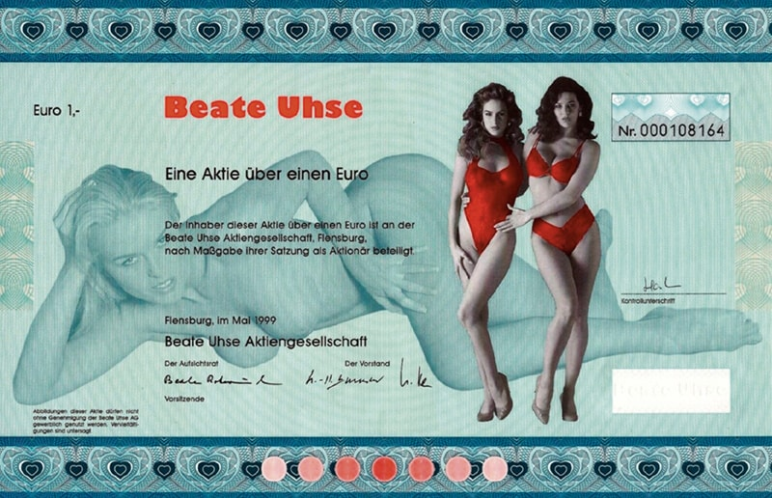
There was also a securities certificate
The “paper share” can currently be bought starting at €20; the latest stock exchange price of a share itself was €0.0060, the delisting process has been initiated.

Slide 10
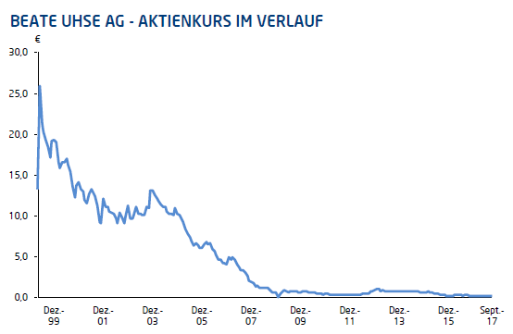
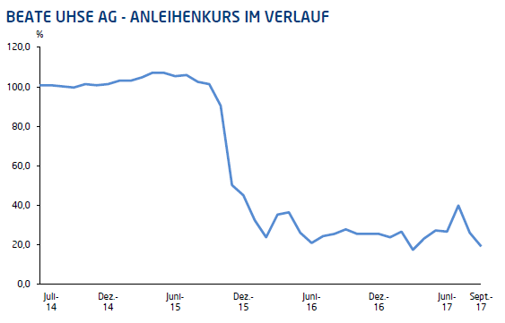
Crisis after growth?
Share price in the course
Bond price over the course
Share price highest on third trading day, but then almost continuous losses
2003 – 2008 market expansion
2008 acquisition of the Playhouse Group (a leading producer and wholesaler in Europe)
External sales revenues plummet within the span of 10 years
Since 2005, the Group has cut its staffing levels by about 1,000
Capital increases in 2008 and 2009 (the “Dutch” taking a capital stake)
Unsecured bond issue having a volume of €30 million, a coupon of 7.75% p.a. and a term of five years

Slide 11
Initial situation
Ongoing strategy, product and liquidity crisis over many years
Unsuccessful attempt to restructure the bond – interest for 2017 must be paid
Resulting liquidity burden in excess of €2 million
All extra-judicial restructuring attempts fail
Beate Uhse AG files for insolvency in self-administration on 15 December 2017
The Flensburg Local Court appointed Sven-Holger Undritz as trustee (Sachwalter) of the assets of Beate Uhse AG and Beate Uhse Netherlands B.V.

Slide 12
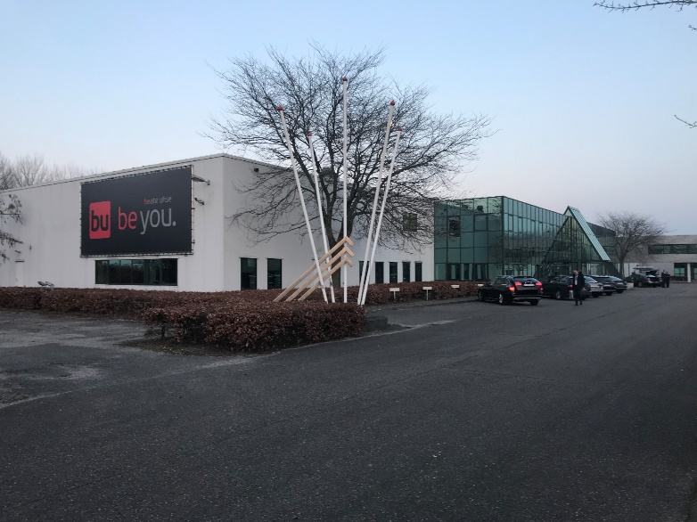
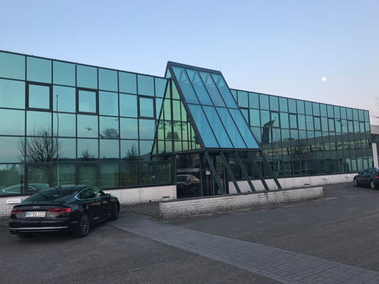
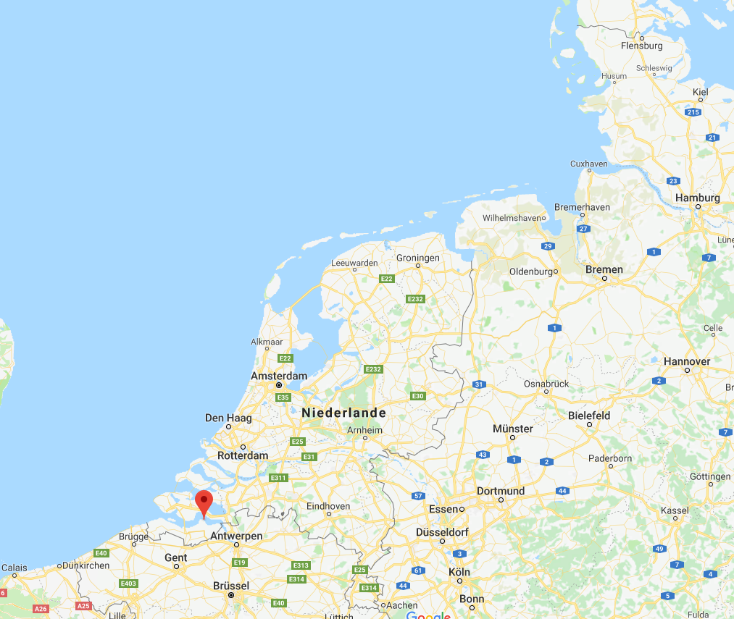
Then we come in… and this is what happens:

Slide 13
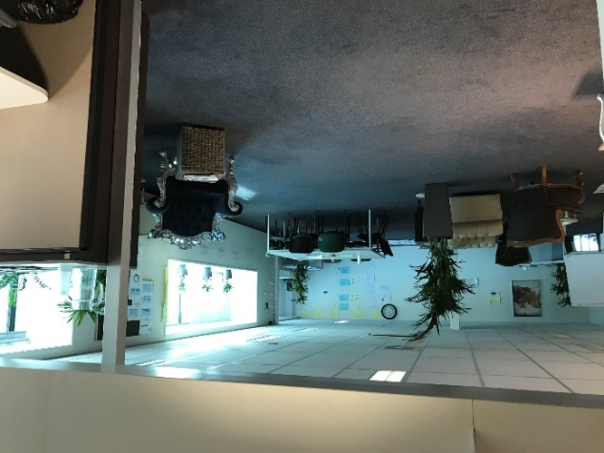
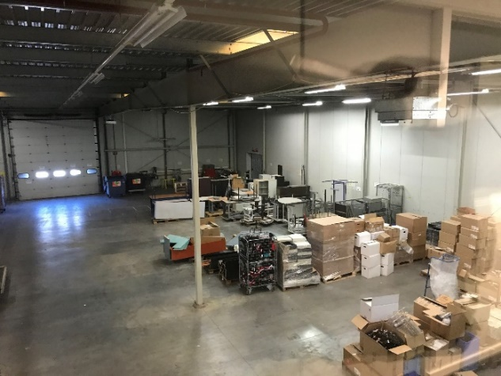
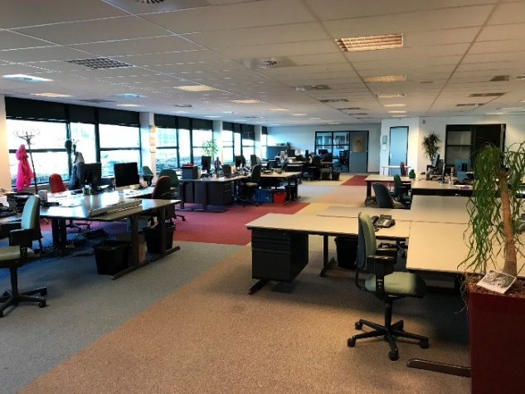
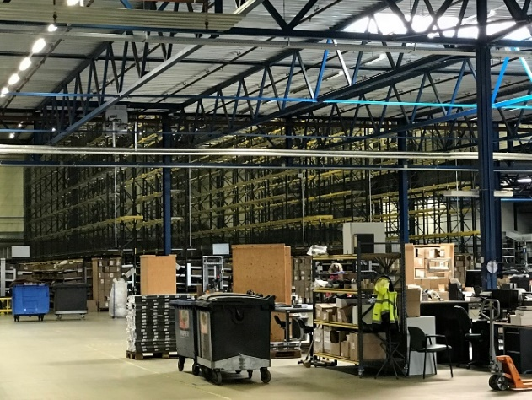
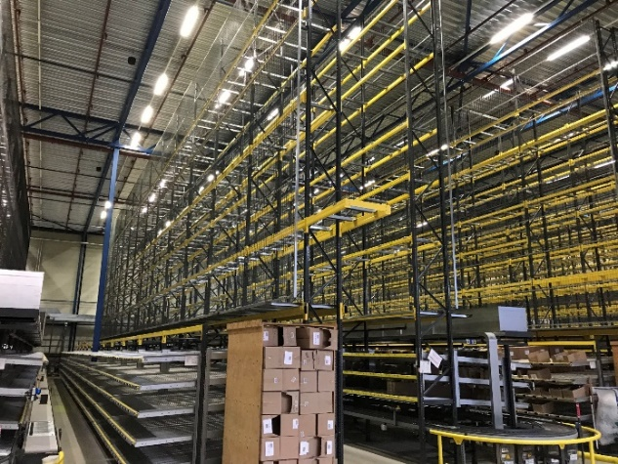
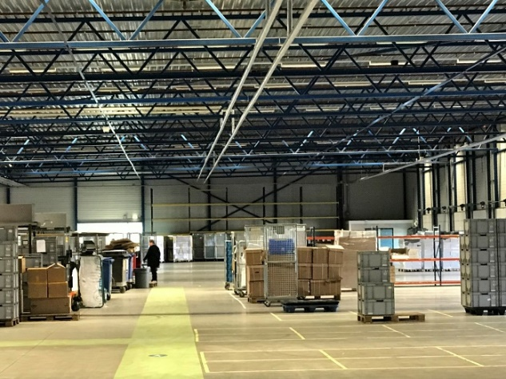
Then we come in… and this is what happens:

Slide 14
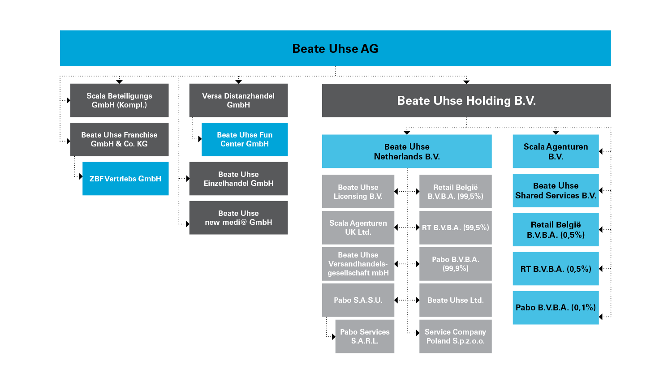
Starting position

Slide 15
Initial approach
Insolvency plan at the level of Beate Uhse AG
As the Restructuring Decree was scrapped, it is difficult to preserve the legal entity by way of a “genuine” debt-to-equity swap of the bondholders
Formation of a NewCo by Beate Uhse AG and transfer of recoverable assets to NewCo
“Quasi” debt-to-equity swap at NewCo

Slide 16
But it turns out differently anyway
Because:
Figures and information from the company don’t add up
Expected sales don’t happen
Creditors who were supposed to be “reined in” change their position
Everything is much more expensive and takes longer than anticipated
In short: just like any other insolvency proceeding

Slide 17
And now?
Target analysis (here: what does the investor want?)
The recoverable assets
At a favourable purchase price
A simplified structure
Transaction securityt
It is helpful when the investor knows what he wants early in the game This was not the case here, requiring continuous adjustments.
Calculation as to what is financially viable
Insolvency of other group companies (because it is cheaper?)

Slide 18
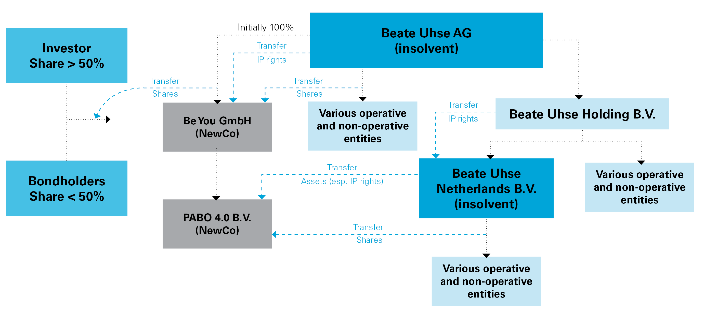
„Interim structure“

Slide 19
What transpired in the meantime…
Combination of insolvency plan proceedings, asset and share deals → Core of the group of companies worth continuing is preserved
One of the rare cases in which an operating foreign company goes through a German insolvency proceedings due to the location of their COMI in Germany
Second case after Nikki (Air Berlin) → unlike the Nikki bankruptcy, however, creditors accepted German jurisdiction
With the help of the financial investor Robus (Prime Capital Debt SCS, SICAV-FIS Robus Recovery Sub-Fund), the viable part of the Beate Uhse Group is preserved

Slide 20
What transpired in the meantime…
After reducing complexity within the Group, the company continues its business under the new brand “be you”
Former successful brands “Adam & Eve” (France) and “Pabo” (Netherlands) are part of the new approach
2019: Knock-on insolvencies → investor underestimated financing requirements
Remaining companies again filed for insolvency: parent company be you GmbH and the three subsidiaries Beate Uhse Einzelhandels GmbH, Versa Distanzhandel and Beate Uhse Fun Center

Slide 21
What transpired in the meantime…
The “new” BU companies affected are now also being liquidated by Sven-Holger Undritz
What remains as a going concern is the online business, which is now being developed further in conjunction with a new partner, the Dutch EDC Group
Formation of a NewCo by Beate Uhse AG and transfer of recoverable assets to NewCo
Juli 2021: Schrift X for a new generation: Beate Uhse revives the legendary sex education booklet from the late 1940s
The Dutch EQOM Group, which the Beate Uhse mail-order business has been part of since 2019, also bought Amorelie, an online sex-toy retailer, in October 2021

Slide 22
Due to a highly complicated group structure with subsidiaries and holding companies in several countries, the restructuring process was a true challenge for the whole team.
Dr. Sven-Holger Undritz

Slide 23
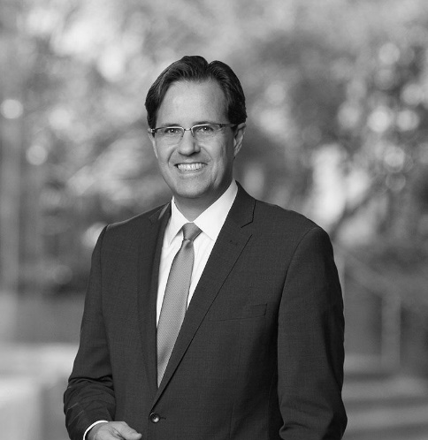
Dr. Sven-Holger Undritz
Lawyer and insolvency administrator
Partner of the international law firm White & Case
Author of various insolvency law commentaries, handbooks and essays
White & Case LLP Valentinskamp 70 / EMPORIO 20355 Hamburg
sven-holger.undritz@whitecase.com

Slide 24
